Slide 1
Project Risk Management
Prepared by Dr. Mutasim Billah Tufail

Slide 2
Outline
Risk Management
Project Risk Management
Business Risk vs Project Risk
Opportunity vs Threat
Risk Response Planning
Risk Appetite and Risk Tolerance
Project risk management Processes
Questions
Case Study

Slide 3
Project Characteristics
Single unit
Many related activities
Difficult production planning and inventory control
General purpose equipment
High labor skills

Slide 4


Examples of Projects
Building Construction
Research Project

Slide 5
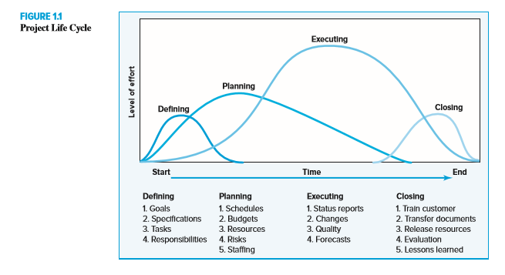
Project Life Cycle.

Slide 6
Why Risk Management?

Slide 7
The PMBOK® defines project risk management as:
‘The processes concerned with conducting risk management planning, identification, analysis, responses and monitoring and control a project. The objective is to:
  Increase the probability and impact of positive events, and to
  Decrease the probability and impact of events adverse to the project objectives’.

Slide 8
A risk is a future event that may or may not happen, but if it does occur it will have an effect on project
scope, (boundaries)
schedule, (Time constrains)
cost, or quality. (budget)
It may have one or more causes and, if it occurs, it may have one or more impacts.
The PMBOK® Guide advises that risks include both
Threats and
Opportunities.

Slide 9
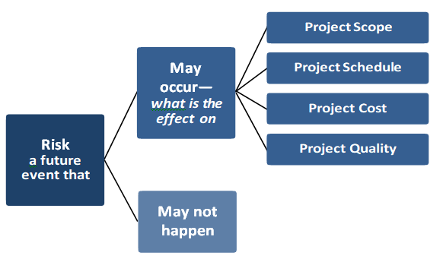
What a project manager needs to know is what is the likelihood a risk will occur and if it does what will it impact as this affects the project plan.

Slide 10


Probability
What is the probability of a donkey can fly???
What is the probability of getting a natural number on a roll of a dice??

Slide 11


Example no 1.
What is the probability of getting head??

Slide 12
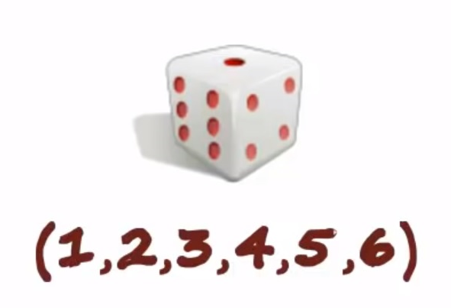
Example 2
What is the probability of getting 4 or P(4)=???
What is the probability of getting even number??

Slide 13

Example 3
P (Jack)= ???
P (Face card)= ???

Slide 14

Pure Risk VS Speculative Risk (2-1)
Pure Risk: (Insurable) Threat of loss without opportunity to gain.
1. Personal Risk: (Premature Death, Poor health, unemployment etc.)
2. Physical Risk: (Property Risk)
Restaurant damage because of fire.
Loss of sale (during the construction of infrastructure)
3.liabblity Risk: Risk occur due to legislation.
4.Risk arises from failure of other: Agreement violation, non compliance/cost overrun.

Slide 15


Pure Risk VS Speculative Risk (2-2)
(profit or loss, Gambling/ Horse race betting
Speculative Risk. (uninsurable)
While pure risk is beyond human control and can only result in a loss if it occurs, speculative risk is taken on voluntarily and can result in either a profit or loss.

Slide 16

Static VS Dynamic Risk
Static Risk:
Not beneficial for Society..
Natural disaster, Theft, Catastrophic.
Dynamic Risk:
Occur because of change in economy.
Internal/ External.
Change in price level, Consumer taste, Exchange rate etc.

Slide 17

Business risks Vs Project risks
The important distinction that must be understood is the difference between business risks and project risks. Business risks are more general and relate to the organization, whereas project risks relate specifically to the project objectives.

Slide 18
Business risk implies uncertainty in profits or danger of loss and the events that could pose a risk due to some unforeseen events in future, which causes business to fail. (Wikipedia)
Project risk is an uncertain event or condition that, if it occurs, has a positive or negative effect on a project’s objectives. (PMI)

Slide 19
For example,
Project scope—to build the stadium to the agreed specification within an agreed timescale and budget.
Project Risk—that the building costs may be higher than expected because of an increase in materials or labor costs.
Business Risk—even if the stadium is constructed on time and within budget that it will not make money for the business. This could be because of lower than expected ticket sales or higher than expected maintenance costs. These risks exist outside of the scope of the project.

Slide 20
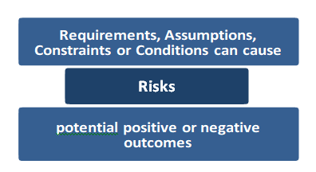
Risks are caused by a requirement, assumption, constraint, or condition that creates the possibility of negative or positive outcomes.

Slide 21
Continuing the previous example:
Risk Cause—change in health and safety legislation during the build phase.
Risk Outcome—increased costs to modify the parts of the stadium in accordance with the new legislation before it can be used.
Project Impact on cost, schedule and performance needs to assessed:
  Shortage of skilled personnel due to demand by other building projects
  Unexpected cost of inspection & license
  The build of the affected parts of the stadium can be brought forward to finish project on time.

Slide 22
Opportunity and Threat
1. “Risk” is an umbrella term, with two varieties:
• “Opportunity” which is a risk with positive effects
• “Threat,” which is a risk with negative effects.
2. “Uncertainty” is the overarching term, with two varieties:
• “Risk” referring exclusively to a threat, i.e., an uncertainty with negative effects
• “Opportunity,” which is an uncertainty with positive effects.
There is no doubt that common lay usage of the word “risk” sees only the downside. This is reflected in the traditional definitions of the word, both in standard dictionaries and in some technical definitions However, some professional bodies and standards organizations have gradually developed their definitions of “risk” to include both upside and downside.
The PMBOK® Guide advises that risks include both threats and opportunities that project managers must assess.
Opportunities have uncertainty associated with them, but they should be grasped, and action taken to ensure that they are realized.
Threats have potentially negative impacts that the project management team should strive to mitigate. (extreme weather conditions)

Slide 23
Risk Response Planning
Risk Response Planning is the process of developing options, and determining actions to enhance opportunities and reduce threats to the project’s objectives. It follows the Qualitative Risk Analysis and Quantitative Risk Analysis processes. It includes the identification and assignment of one or more persons (the “risk response owner”) to take responsibility for each agreed-to and funded risk response. Risk Response Planning addresses the risks by their priority, inserting resources and activities into the budget, schedule, and project management plan, as needed.

Slide 24
Negative Risk Response Strategies (Threat)
Avoidance - eliminate the threat to protect the project from the impact of the risk. Eg (Covid-19 work from home)
Mitigation - Effort is made to reduce the probability, impact, or both of an identified risk in the project before the risk event occurs.
Eg (seatbelt to reduce the potential impact of an accident)
Transference - The risk is assigned to a third party, usually for a fee. The risk still exists, but the responsibility is deflected to the third party. Eg (Purchasing insurance for your home doesn’t reduce or eliminate damage from a storm, but it does provide a financial safety net in the event damages do occur.)
Accept – acknowledge the risk, but do not take any action unless the risk occurs. An example of this is documenting the risk and putting aside funds in case the risk occurs.

Slide 25
Positive Risk Response Strategies (Opportunity)
Tools and Techniques for Risk Response Planning; it’s important to know how to handle both positive and negative risk.
Exploit - Used in conjunction with positive impacts where the host organization wants to ensure the positive risk definitely happens. EG (You give overtime to your team members, bring in more employees, motivate the team members by announcing rewards if they help you complete the project ahead of time)
Share - 3rd party partnerships that include forming risk-sharing partnerships, teams, special-purpose companies, or joint ventures, which can be established with the express purpose of managing opportunities.
Enhance - Seeks to facilitate or strengthen the cause of the opportunity, and proactively targeting and reinforcing its trigger conditions, to potentially increase probability. For example, let’s say you will complete your project in three months and the government is about to float a similar project in two months. You can bid for a new project if you complete your project in two months.
Accept
In the accept risk response strategy, you take no action to realize the opportunity. You leave the opportunity as is, and if it happens on its own, you will benefit from it. For example, suppose you may get skilled workers from another project at a lower rate if you convince them to join you. However, you do not pursue this matter and instead, let them decide whether or not they are interested in your project.

Slide 26
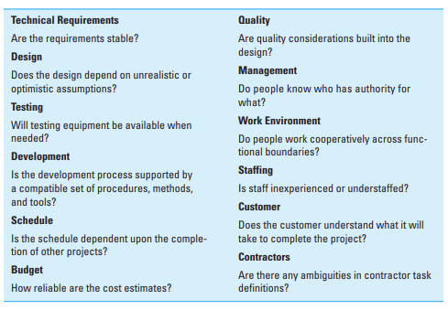
Partial Risk Profile for Product Development Project

Slide 27
Risk Tolerance
Organizations and stakeholders are willing to accept varying degrees of risk. This is called risk tolerance. Risks that are threats to the project may be accepted if they are in balance with the rewards that may be gained from taking them. For example,
Using unproven productivity-boosting software is a risk taken in the expectation that the work will be completed more quickly and with fewer resources.(unlicensed MS Windows)

Slide 28
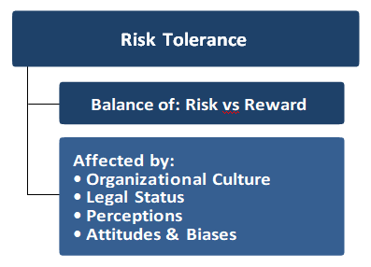
The risk of the software not performing as advertised would need to be considered as part of the risk assessment.
All organizations have a ‘risk tolerance’ that is affected by their legal status and their culture. For instance, a pension fund is likely to be more risk averse than a small start up company. In all cases, attitudes to risk are driven by perception, tolerances, and other biases, which should be made explicit wherever possible.

Slide 29
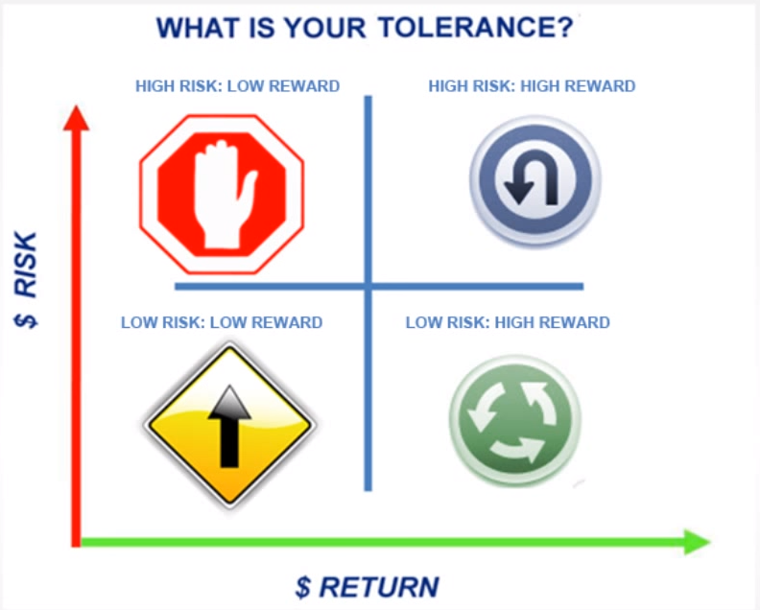

Slide 30
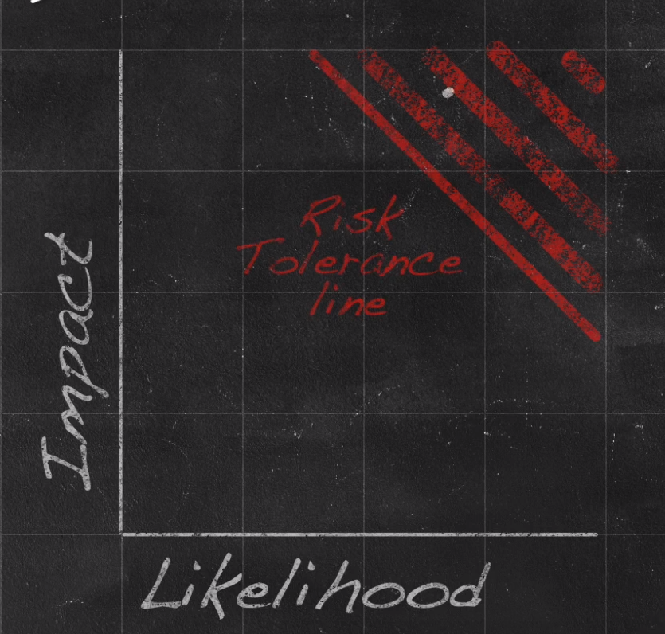

Slide 31
Risk appetite: A target level of loss exposure that the organization views as acceptable, given business objectives and resources.
Risk tolerance: The degree of variance from the organization’s risk appetite that the organization is willing to tolerate.

Slide 32
Risk Appetite vs Risk Tolerance
According to the IIA (institute of internal audit), both risk appetite and risk tolerance set boundaries of how much risk an entity is prepared to accept, but there is an important difference between risk appetite vs risk tolerance.
A risk appetite statement is a higher level statement that broadly considers the levels of risk management deems acceptable, while risk tolerances are narrower and set the acceptable level of variation around objectives.
A risk appetite statement example would be when a company says it does not accept risks that could result in a significant loss of its revenue base.
When the same company says it does not wish to accept risks that would cause revenue from its top 10 customers to decline by more than 10%, it is expressing a risk tolerance definition.
(example of over speeding and highway ticket)

Slide 33
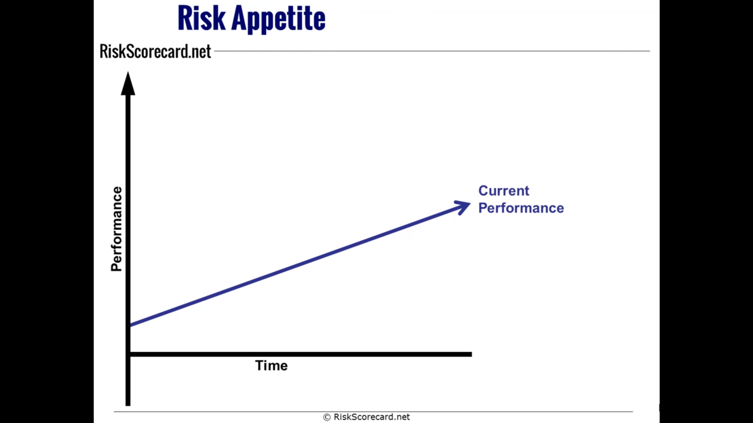

Slide 34
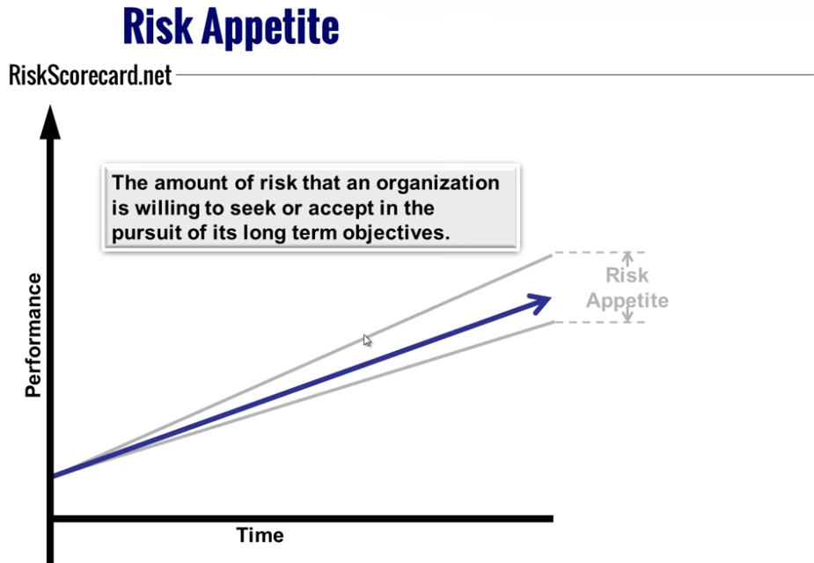

Slide 35
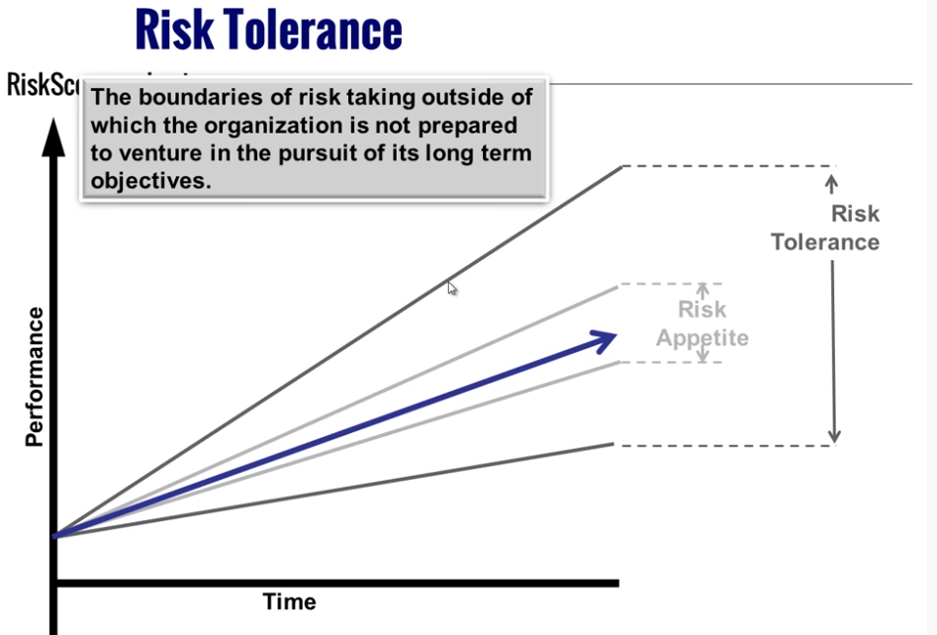

Slide 36
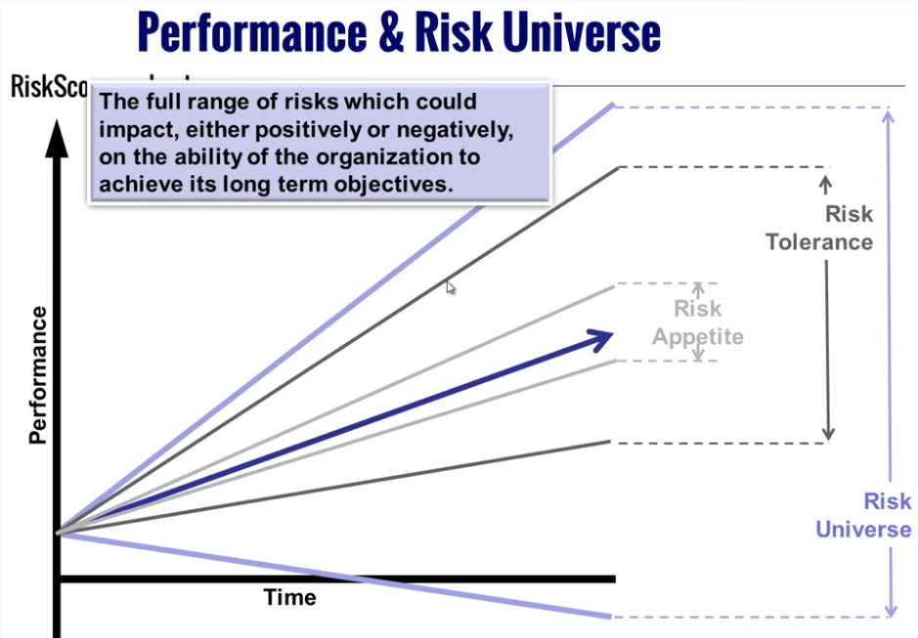

Slide 37
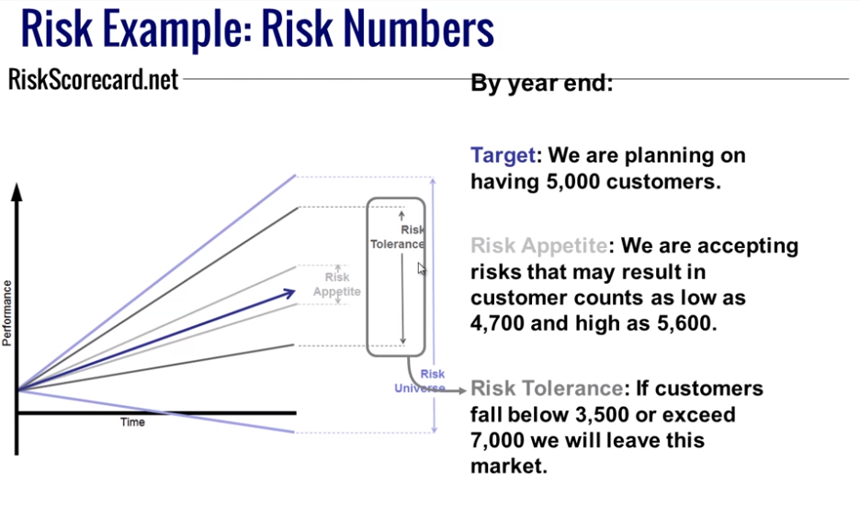

Slide 38
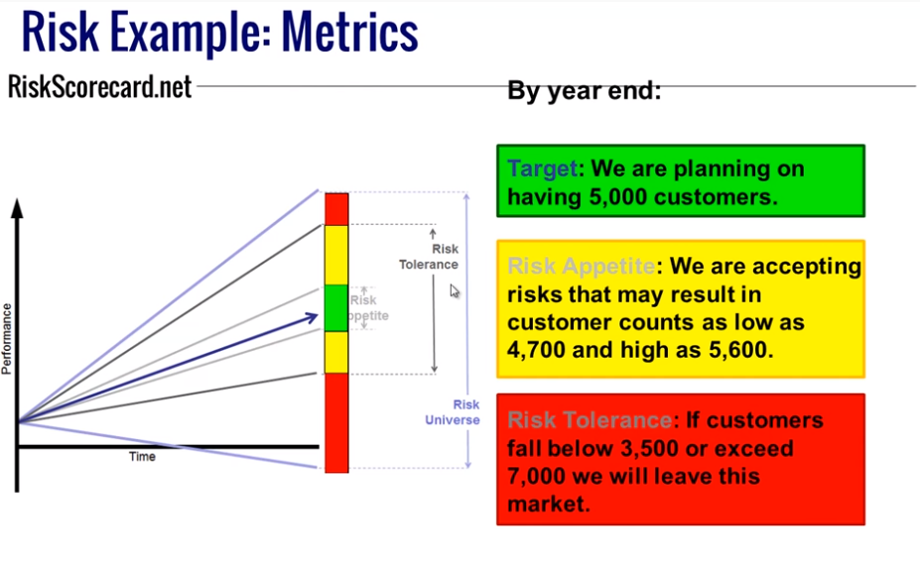

Slide 39
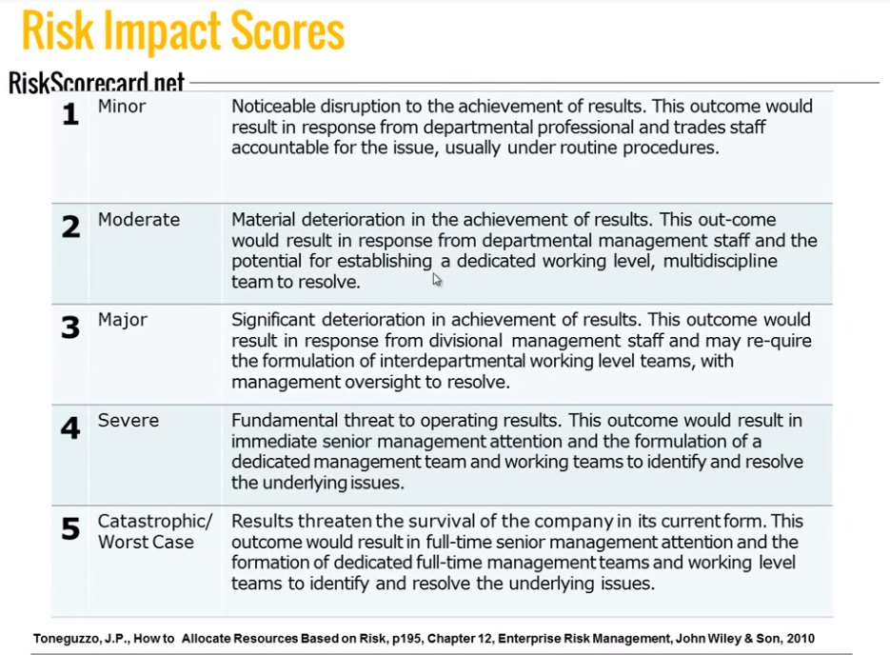

Slide 40
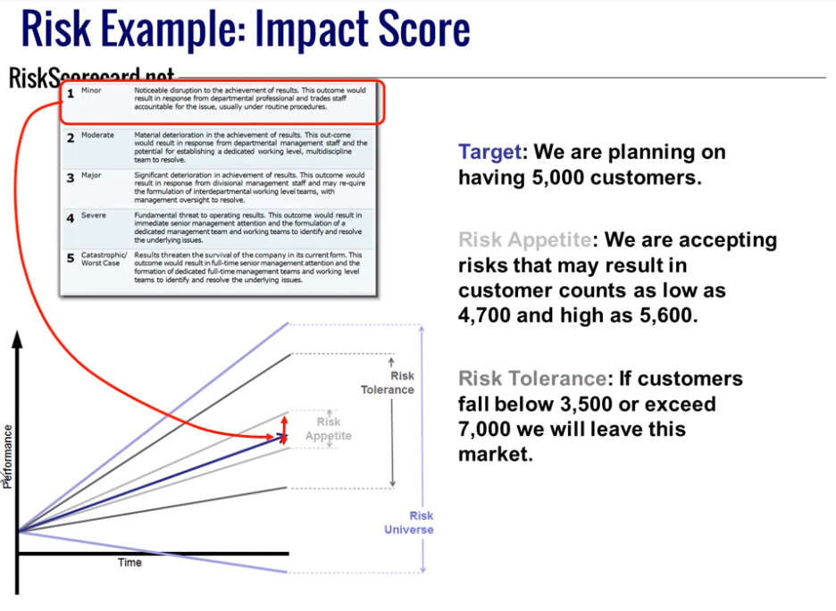

Slide 41
The PMBOK® Project Risk Management Processes
There are six PMBOK® Project Procurement Management processes in this knowledge area:
  Plan Risk Management—the process of defining how to conduct risk management activities for a project.
  Identify Risks—the process of determining which risks may affect the project and documenting their characteristics.
Perform Qualitative Risk Analysis—the process of prioritizing risks for further analysis or action by assessing and combining their probability of occurrence and impact.
Cont.

Slide 42
Cont.
  Perform Quantitative Risk Analysis—the process of numerically analyzing the effect of identified risks on overall project objectives.
  Plan Risk Responses—the process of developing options and actions to enhance opportunities and to reduce threats to project objectives.
  Monitor and Control Risks—the process of implementing risk response plans, tracking identified risks, monitoring residual risks, identifying new risks, and evaluating risk process effectiveness throughout the project.

Slide 43
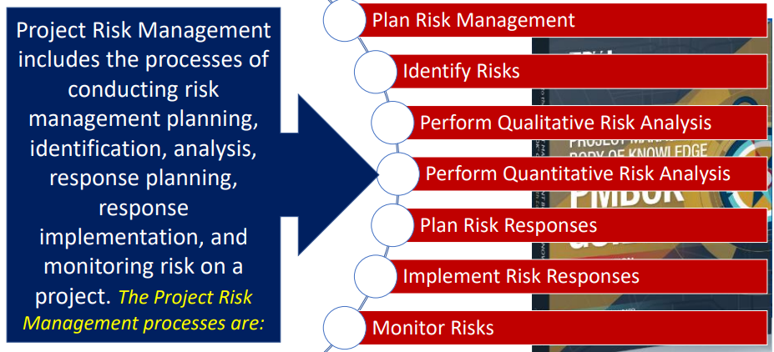

Slide 44
Exercise
Define risk management and relate its purpose to the organisation.
Differentiate between risk, peril and hazard.
Explain how risk can affect the individual and organization.

Slide 45
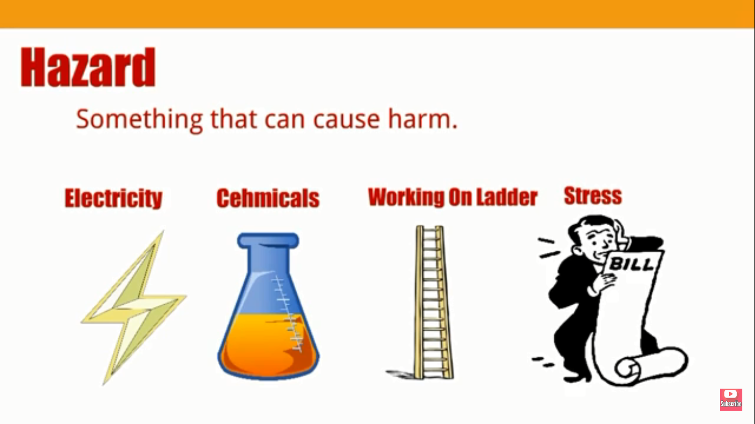

Slide 46
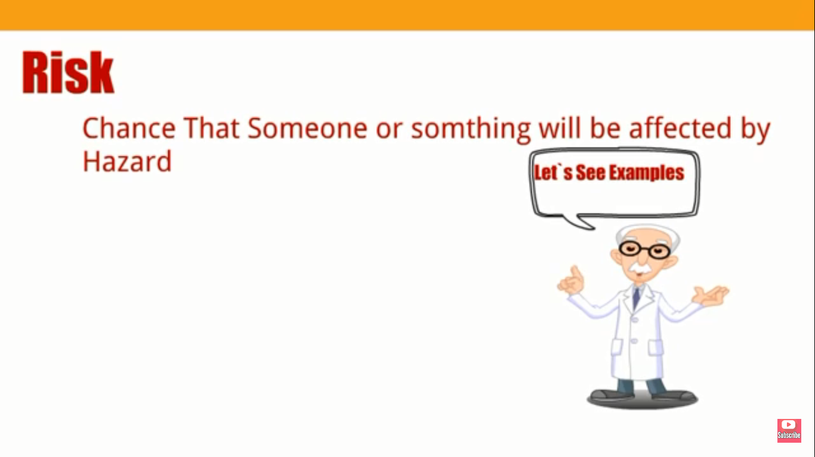

Slide 47
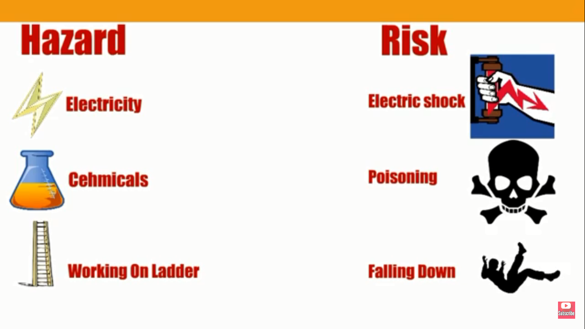

Slide 48
Video link
https://www.youtube.com/watch?v=rM0tjJRpK0c

Slide 49
Difference B/W Risk Peril and Hazard
Peril, risk, and hazard are three words used frequently in my business. And according to the Oxford English Dictionary, they have very similar definitions:
Peril: Serious and immediate danger.
Risk: Situation involving exposure to danger.
Hazard: Danger or risk.
You could get away with interchanging these words in day-to-day conversation. But in insurance and financial circles, they each have a distinct meaning and it’s important to understand their differences.
Consider the same words as defined by the Glossary of Insurance and Risk Management Terms:
Peril: Cause of loss.
Risk: Uncertainty arising from the possible occurrence of given events that would result in loss with no opportunity for gain.
Hazard: Condition that increases the probability of loss.
To summarize: hazards increase the risk of a specific peril.

Slide 50
What is a Case Study?
A case study analysis requires you to investigate a business problem, examine the alternative solutions, and propose the most effective solution using supportive evidence.
A case study should include background information on the specific topic, an analysis of the case under student showing problems or effective strategies, as well as recommendations. A case study can focus on a business or entire industry, a specific project or program, or a person.

Slide 51
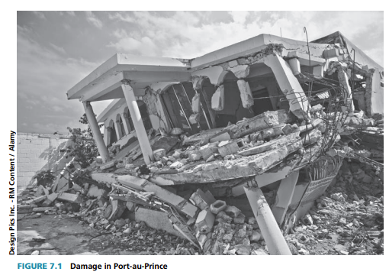
Case—Haitian Earthquake Relief

Slide 52
Question: Do you agree with the following statement: “With proper planning it is possible to eliminate most/all risks from a project”? Why or why not?

Slide 53
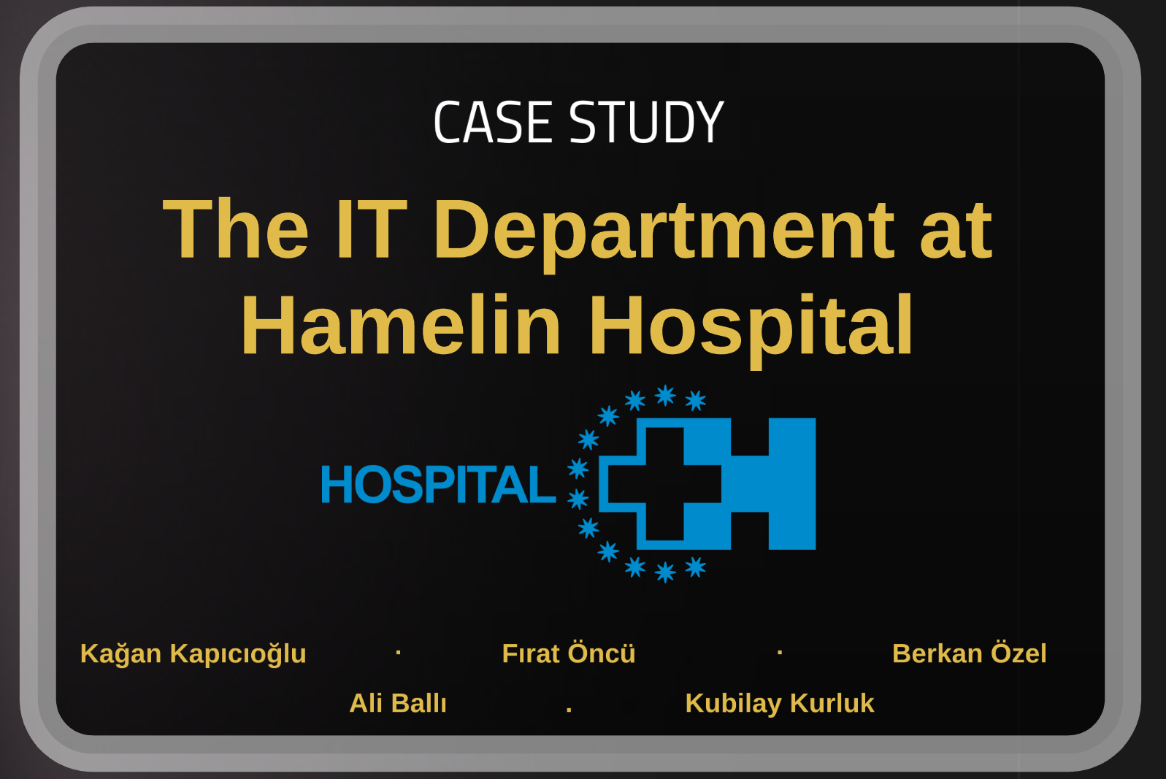

Slide 54
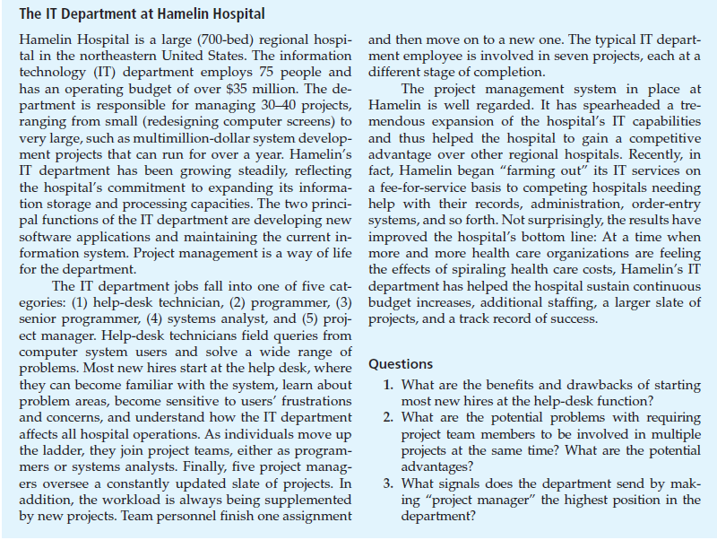
https://prezi.com/flslhli_pjxf/the-it-department-at-hamelin-hospital/

Slide 55
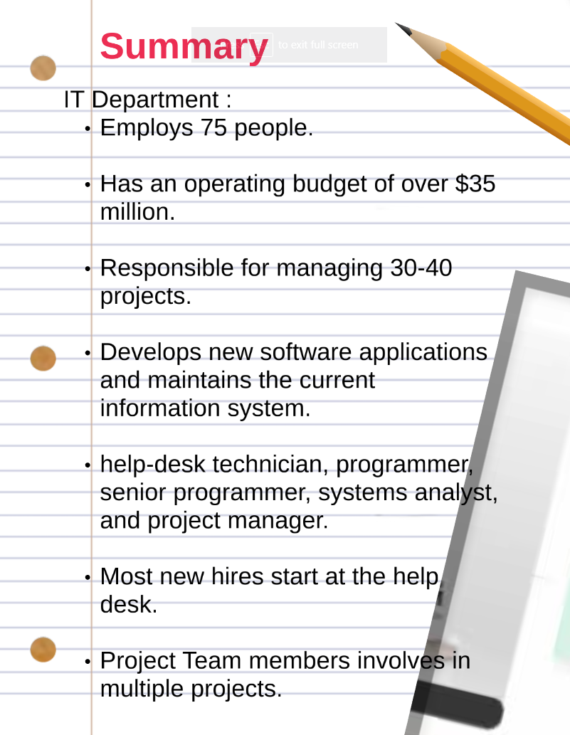

Slide 56
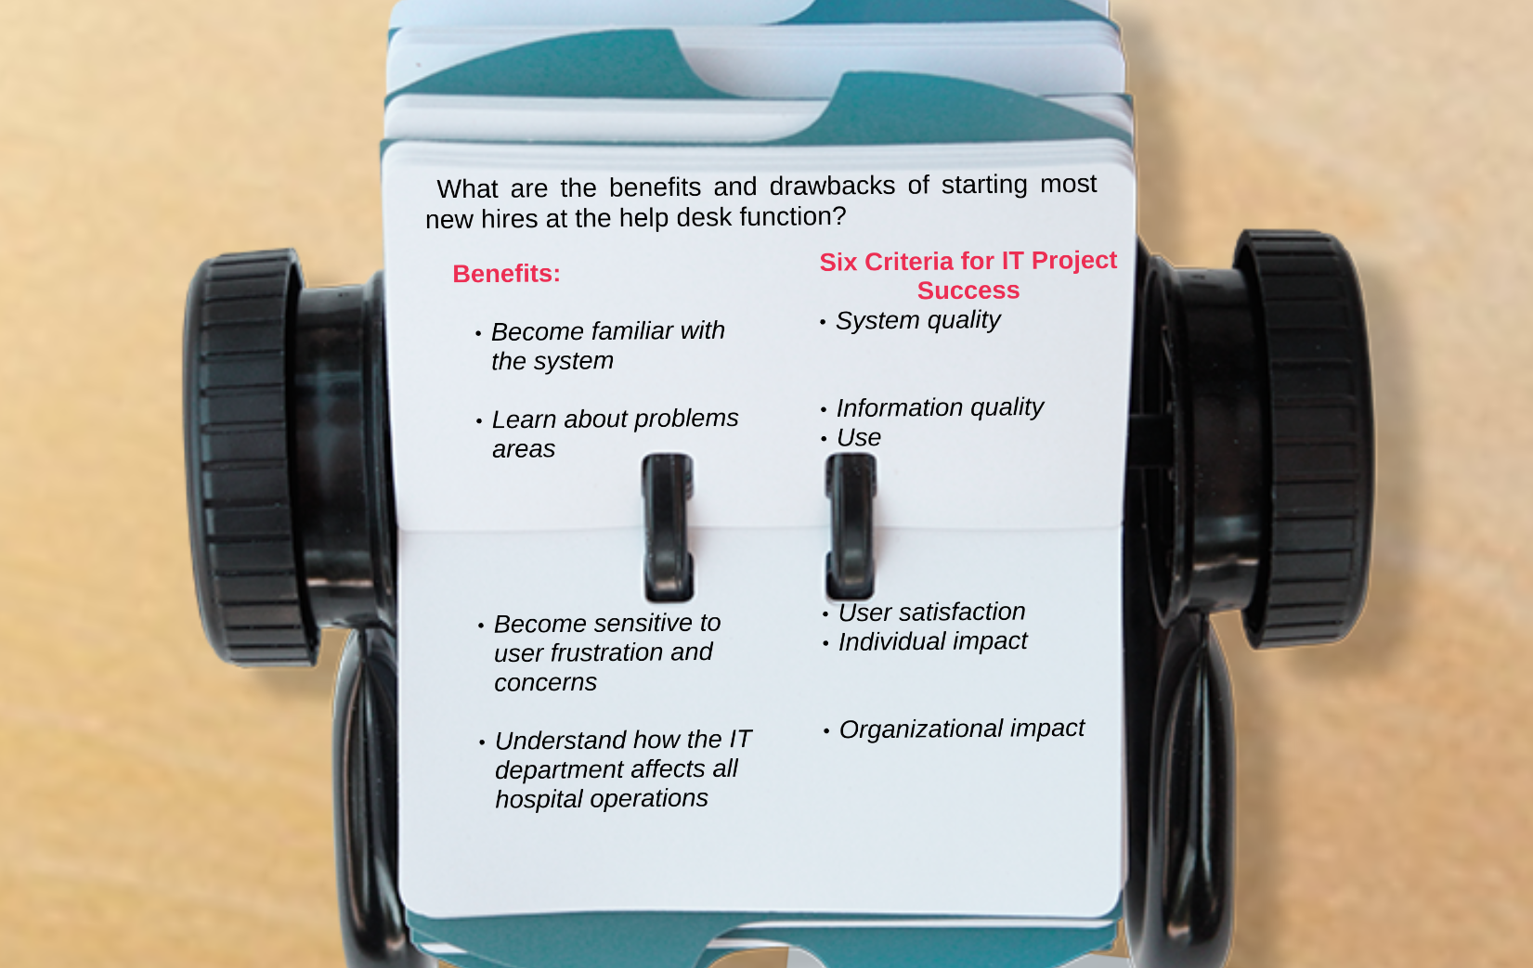

Slide 57
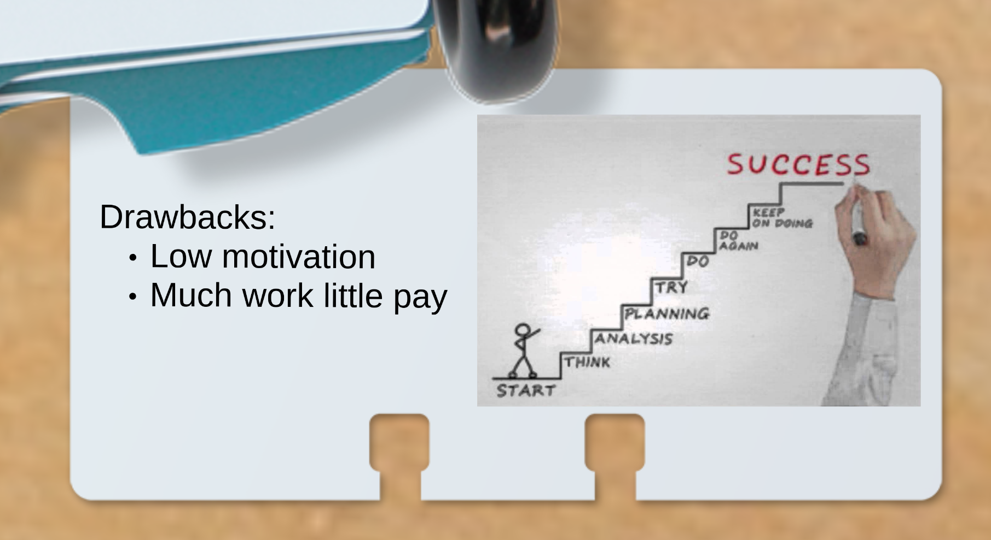

Slide 58
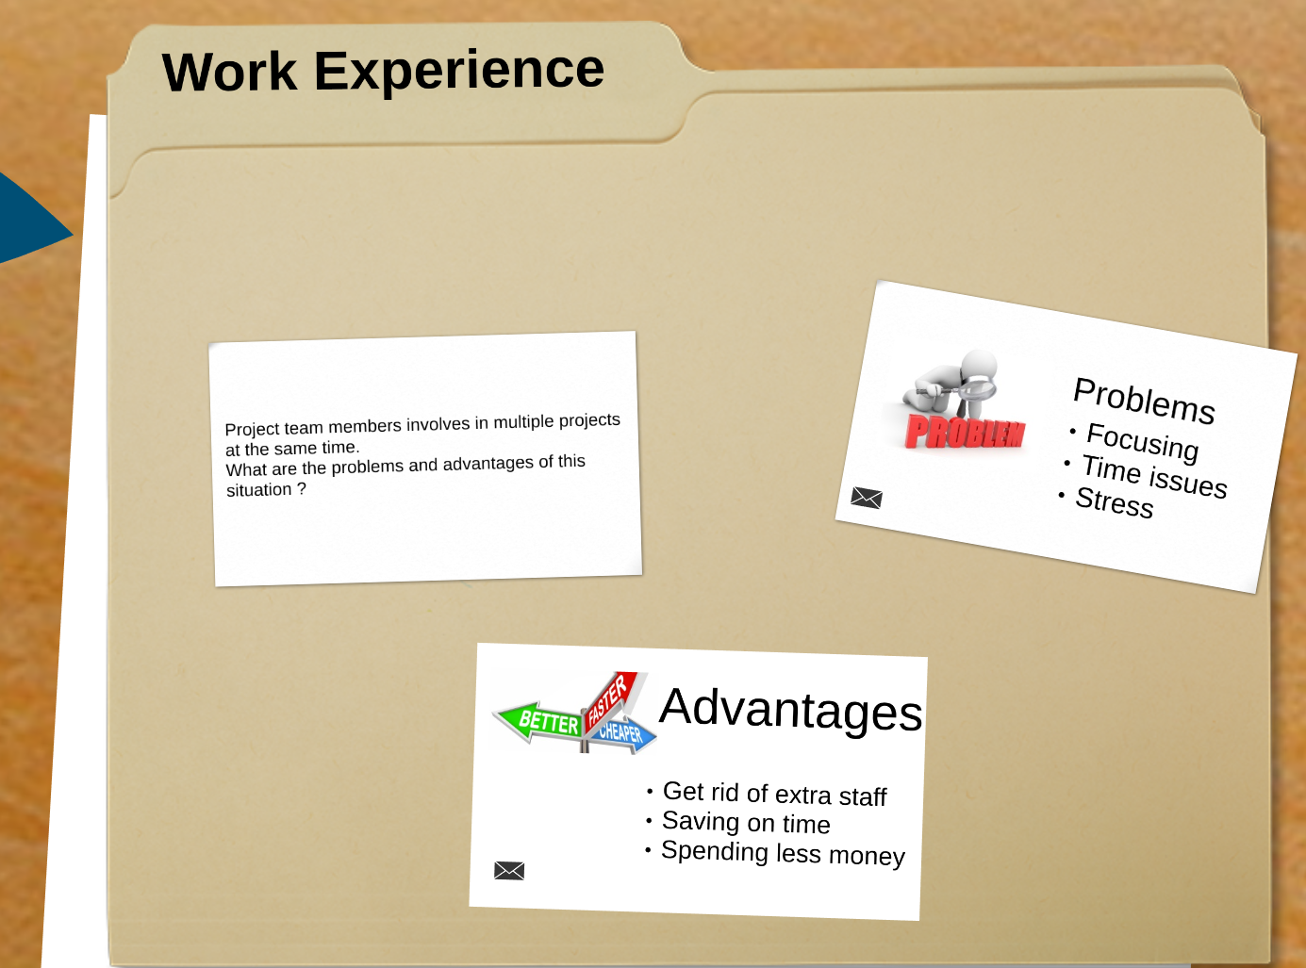

Slide 59
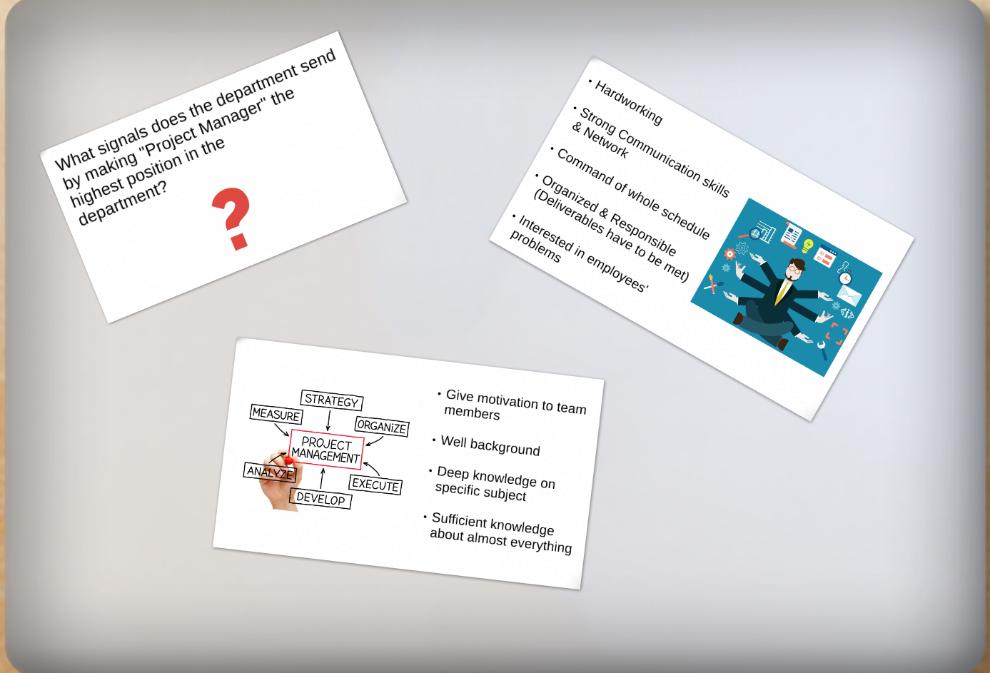

Slide 60
Risk Management Planning

Slide 61
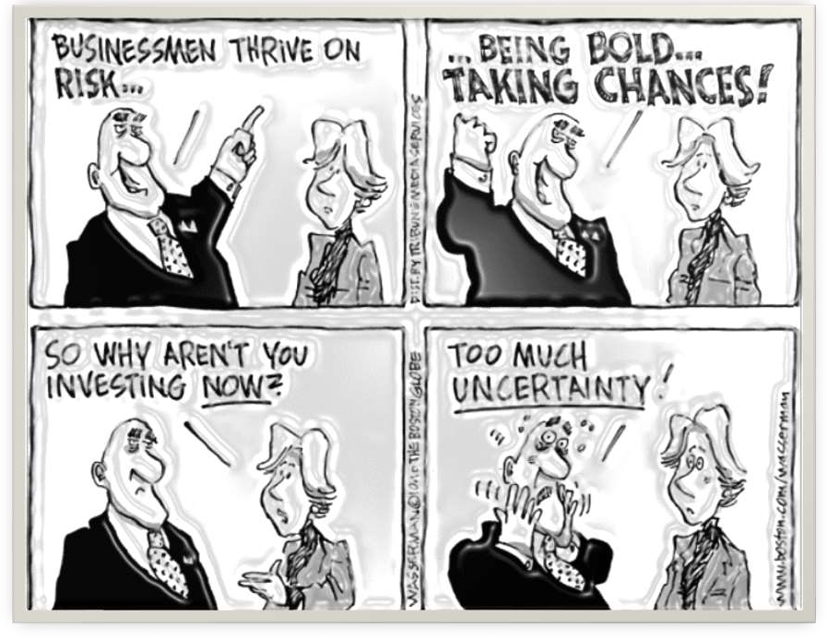

Slide 62
Case study
Samsung’s Galaxy Note 7—
Failure to Manage a New Product for Risk

Slide 63
Types of Project Risk
Risk exists at two levels within every project.
Individual project risk
Overall project risk

Slide 64
Individual project
Individual project risk is an uncertain event or condition that, if it occurs, has a positive or negative effect on one or more project objectives.
Individual project risks can have a positive or negative effect on project objectives if they occur. Project Risk Management aims to exploit or enhance positive risks (opportunities) while avoiding or mitigating negative risks (threats). Unmanaged threats may result in issues or problems such as delay, cost overruns, performance shortfall, or loss of reputation. Opportunities that are captured can lead to benefits such as reduced time and cost, improved performance, or reputation.

Slide 65
Overall project risk
Overall project risk is the effect of uncertainty on the project as a whole, arising from all sources of uncertainty including individual risks, representing the exposure of stakeholders to the implications of variations in project outcome, both positive and negative.
Overall project risk can also be positive or negative. Management of overall project risk aims to keep project risk exposure within an acceptable range by reducing drivers of negative variation, promoting drivers of positive variation, and maximizing the probability of achieving overall project objectives.
.

Slide 66
TRENDS AND EMERGING PRACTICES IN PROJECT RISK MANAGEMENT
1. Non-event risks.
Variability
Ambiguity
2. Project resilience.

Slide 67
event risks. Most projects focus only on risks that are uncertain future events that may or may not occur.
Examples of event-based risks include:
a key seller may go out of business during the project, the customer may change the requirement after design is complete,

Slide 68
There is an increasing recognition that non-event risks need to be identified and managed. There are two main types of non-event risks:
Variability risk. Uncertainty exists about some key characteristics of a planned event or activity or decision.
Examples of variability risks include: productivity may be above or below target, the number of errors found during testing may be higher or lower than expected, or unseasonal weather conditions may occur during the construction phase.
Ambiguity risk. Uncertainty exists about what might happen in the future. Areas of the project where imperfect knowledge might affect the project’s ability to achieve its objectives include: elements of the requirement or technical solution, future developments in regulatory frameworks, or inherent systemic complexity in the project.

Slide 69
Project resilience.
The existence of emergent risk is becoming clear, with a growing awareness of so-called unknowable-unknowns. These are risks that can only be recognized after they have occurred.
Resilience meaning the capacity to recover quickly from difficulties; toughness.

Slide 70
TAILORING CONSIDERATIONS
Because each project is unique, it is necessary to tailor the way Project Risk Management processes are applied. Considerations for tailoring include but are not limited to:
Project size. Does the project’s size in terms of budget, duration, scope, or team size require a more detailed approach to risk management? Or is it small enough to justify a simplified risk process?
Project complexity. Is a robust risk approach demanded by high levels of innovation, new technology, commercial arrangements, interfaces, or external dependencies that increase project complexity? Or is the project simple enough that a reduced risk process will suffice?

Slide 71
TAILORING CONSIDERATIONS (Cont.)
Project importance.
How strategically important is the project? Is the level of risk increased for this project because it aims to produce breakthrough opportunities, addresses significant blocks to organizational performance, or involves major product innovation?
Development approach.
Is this a waterfall project, where risk processes can be followed sequentially and iteratively, or does the project follow an agile approach where risk is addressed at the start of each iteration as well as during its execution?

Slide 72
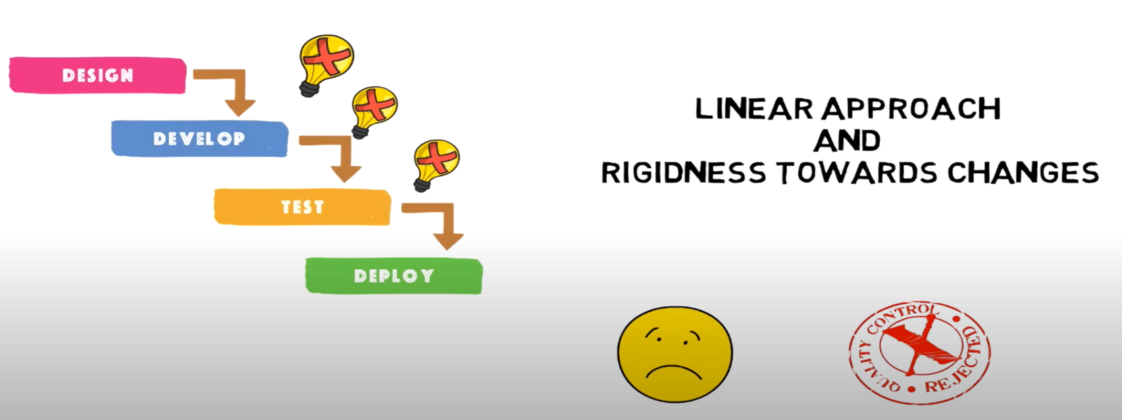
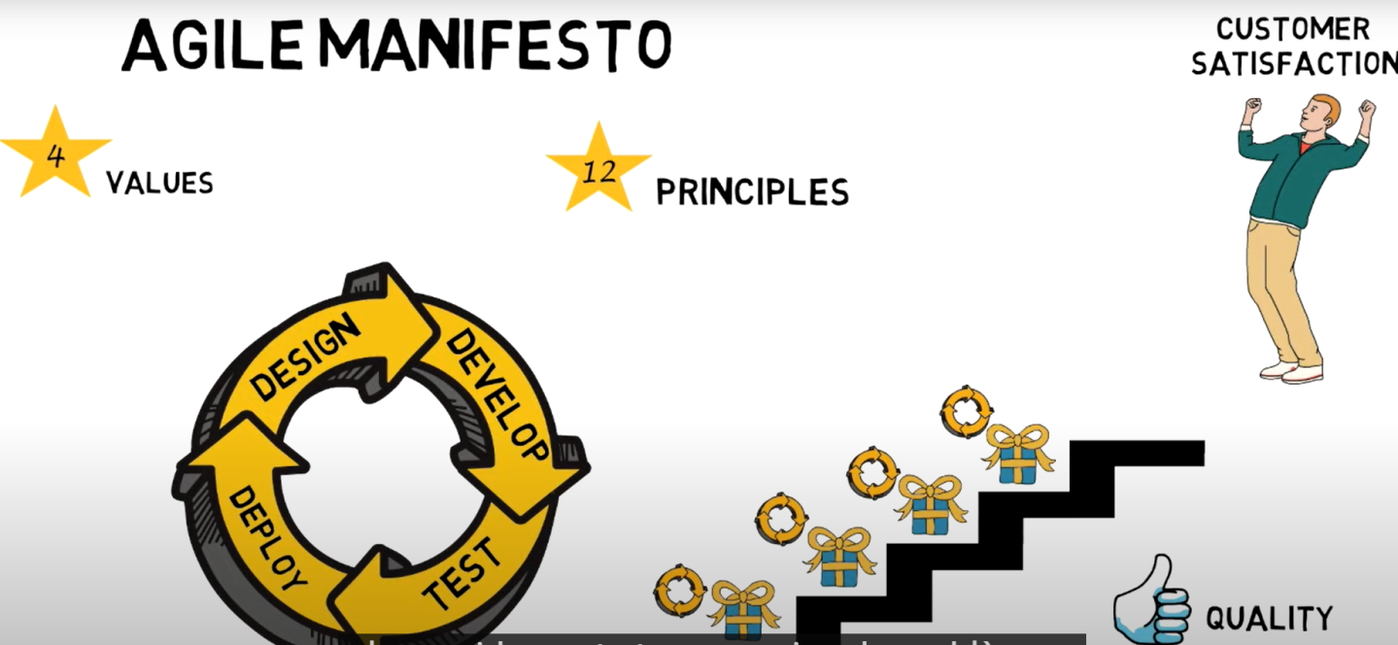
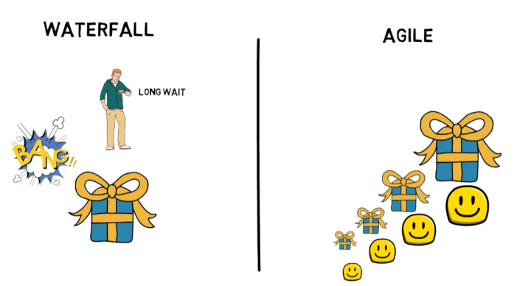
Waterfall vs Agile
Fix Budget
Fix Scope
Fix time
Optimum Quality

Slide 73
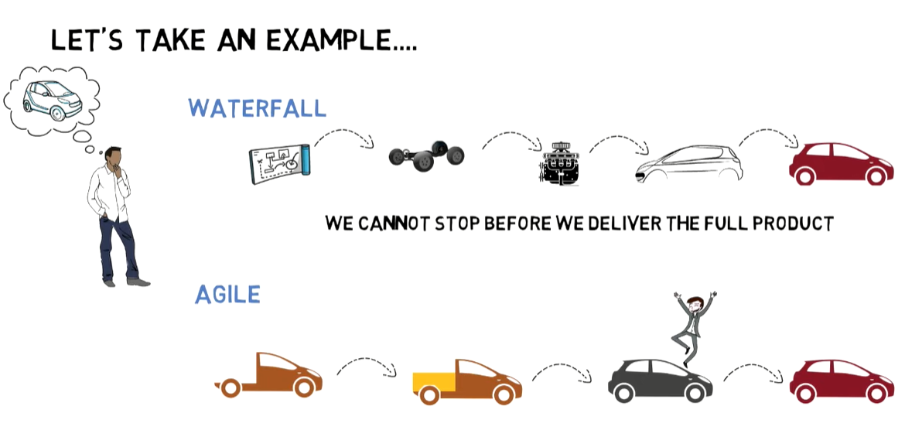
Waterfall vs Agile

Slide 74
DEFINITION OF RISK MANAGEMENT
Risk management is the act or practice of dealing with risk. It includes planning for risk, assessing (identifying and analyzing) risk issues, developing risk handling strategies, and monitoring risks to determine how they have changed.
Risk management is not a separate project office activity assigned to a risk management department, but rather is one aspect of sound project management.
Risk management should be closely coupled with key project processes, including but not limited to: overall project management, systems engineering, cost, scope, quality, and schedule.

Slide 75
Project Risk Assessment is Proactive or Reactive Process??

Slide 76
Proactive Vs Reactive
Proper risk management is proactive rather than reactive. As an example, an activity in a network requires that a new technology be developed. The schedule indicates six months for this activity, but project engineers think that nine months is closer to the truth. If the project manager is proactive, he might develop a Risk Handling Plan right now. If the project manager is reactive (e.g., a “problem-solver”), then he will do nothing until the problem actually occurs. By that time the project manager will have lost valuable time when contingencies could have been developed. Hence, proper risk management will attempt to reduce the likelihood of an event occurring and/or the magnitude of its impact.
https://www.youtube.com/watch?v=b1EtsGKlW-s

Slide 77
  Plan Risk Management
This is the process of creating the risk management plan. This plan details how the project management team will perform risk management for this project. It does not involve actually identifying project risk.
Aim of Risk Management Plan—is to ensure that the risk management protocol that is used on the project is commensurate with both the risks and the importance of the project to the organization.
Establishing this protocol early on in the project ensures that all members of the project management team are using the same methods to evaluate risks and that the risk management tasks are budgeted for in the project plans.
The level of detail in the risk management plan will depend upon the level of risk within the project and the level of risk that the performing organization is prepared to take.

Slide 78
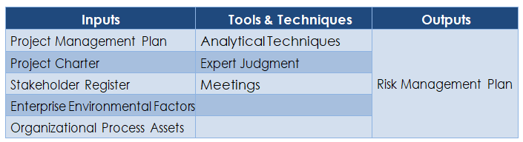
Risk Management Plan
The inputs, tools and techniques, and outputs of this process are summarized in the table below.

Slide 79
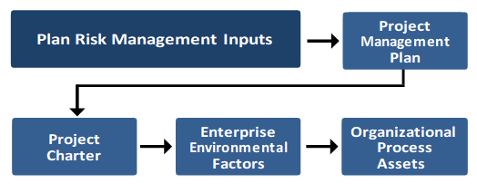
    Plan Risk Management: Inputs
This process requires the following inputs:

Slide 80
      Project Management Plan
All approved subsidiary management plans and baselines should be taken into consideration in order to make the risk management plan consistent with them. For example,
        Scope Statement defines the scope of the project, which will have a direct bearing on the type and amount of risk that is likely to be encountered. It provides a clear definition of such risk areas.
        The Cost Management Plan defines how risk in terms of budgets, contingencies, and management reserves will be reported and accessed.
        The Schedule Management Plan includes information about activities and their timing including aspects such as internal and external constraints that will help identify risk areas.
        The Communications Management Plan includes information on all key stakeholders and in particular their concerns for specific risks, and hence, how such communications should be handled.

Slide 81
Project Management Plan
Project Management Plan
Veriables | Define | Manage | Control
Scope
Cost
Schedule
Quality

Slide 82

Why you need Project charter?
What you see in this picture?
A young lady or old Women??

Slide 83
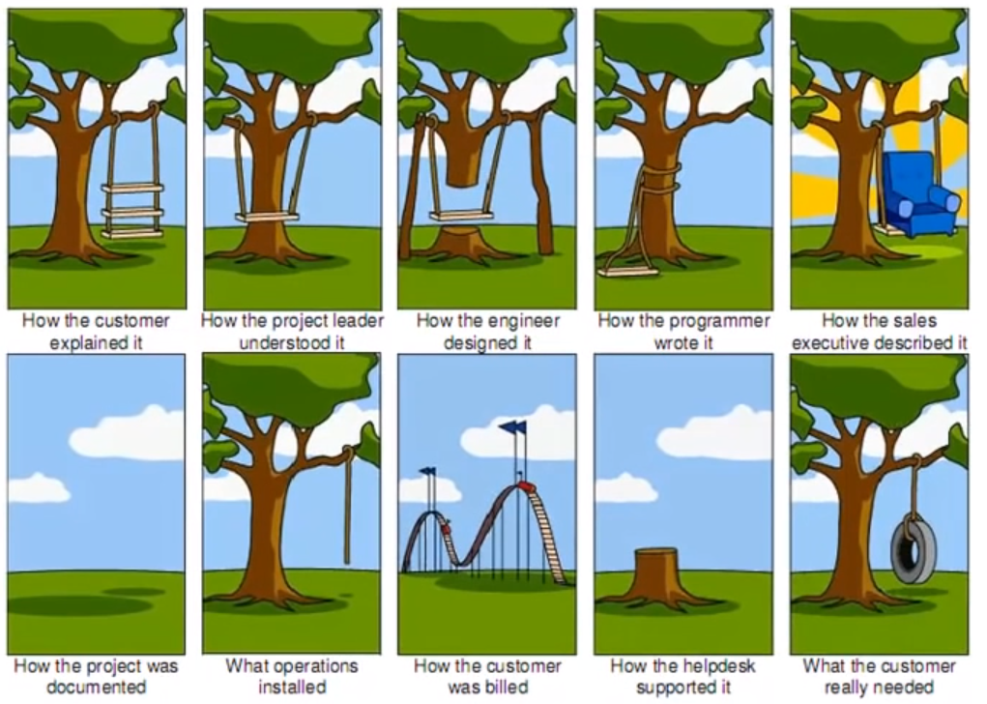
Why you need Project charter?

Slide 84
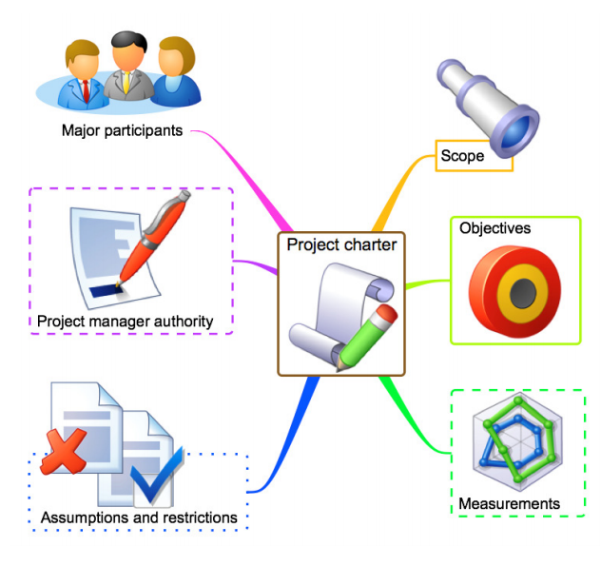
Project Charter
Project Charter
The Project Charter describes the project vision and objectives (the reasons for doing the work). It also summarizes at a high level the overall project strategy, scope, organization and implementation. It helps to set the direction for the project and gain buy in from key stakeholders as to how the project will be organized and implemented. It also helps control the scope of the project, by defining exactly what it is that you have to achieve.

Slide 85
Project Charter
Class exercise.

Slide 86
      Enterprise Environmental Factors (EEF)
Conditions, not under the immediate control of the team, that influence, constrain, or direct the project, program, or portfolio.
Examples of environmental factors:
Organizational culture & structure
Infrastructure
Resources
Database structure or tool
Things we consider
Working in container
Data base using for process.

Slide 87
According to the PMBOK® Guide, 6th edition, the following are part of Enterprise Environmental Factors:
Internal:
• Organizational structure
• Infrastructure
• The skills, disciplines and knowledge of human resources
• Personnel administration
• Stakeholder risk tolerances
External:
• Governmental or industry standards
• Commercial databases
• Marketplace conditions
(eg Shall petroleum increased dollar prices)

Slide 88
Organizational Process Assets (OPA)
Definition: Plans, processes, policies, procedures, and knowledge bases that are specific to and used by the performing organization (Project Relevant information)
Examples of process related assets:
Policies and procedures
Formal and informal plans
Lessons learned
Historical information
Things we use
Further categorized in project Corporate Knowledge Base and
Work Processes and Procedures:

Slide 89
Corporate Knowledge Base:
• Project files
• Historical information
• Lessons Learned Knowledge Base
• Issue and defect management database (contains status)
Risk register
Stakeholder Register

Slide 90
Work Processes and Procedures:
Policies
Procedures
General Guideline
STANDARD Template

Slide 91
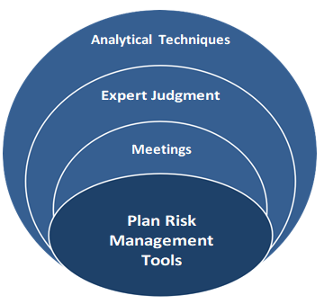
    Plan Risk Management: Tools and Techniques
There are three tools and techniques that can be used.

Slide 92
      Analytical Techniques
These are used to understand and define the overall risk management context of the project, which is based on a combination of stakeholder risk attitudes and the strategic risk exposure of the current project.
      Expert Judgment
This usually takes the form of expertise collated from:
        Subject matter experts
        Project stakeholders
        Senior management
        Lessons learned from previous projects.

Slide 93
      Meetings
These involve people who are responsible for risk management including the project manager, the project sponsor, selected project team members, selected stakeholders, anyone with responsibility for any of the risk management processes, and others as needed.
Collective decision-making is very important area of project management.
Almost all of the processes that form part of project risk management will involve meetings between the project manager, the team and other stakeholders in order to make decisions about the activity definitions and associated estimates.
How well these meetings are conducted will have a major impact on how smoothly the project runs.

Slide 94
    Plan Risk Management: Outputs
This process will create only one output, the risk management plan.
Risk Management Plan
This plan forms part of the project management plan and describes how risk management will be structured and performed on the project. It contains the following elements:
        Methodology
        Roles & Responsibility
        Budgeting
        Timing
        Risk categories
        Definitions of Risk Probability & Impact
        Probability & Impact Matrix
        Revised Stakeholder Risk Tolerances
        Reporting Formats
        Tracking

Slide 95
Methodology
Defines the approaches, tools, and data sources that may be used to perform risk management on the project.
Roles and Responsibilities
This part of the plan needs to make clear who is responsible for each type of activity in the risk management plan, and clarifies their responsibilities.
Budgeting
This part of the plan assigns resources, estimates funds needed for risk management for inclusion in the cost performance baseline, and establishes how any extra funding required (if risks are realized) will be raised.
Timing
This part of the plan defines when and how often the risk management process will be performed throughout the project life cycle.

Slide 96
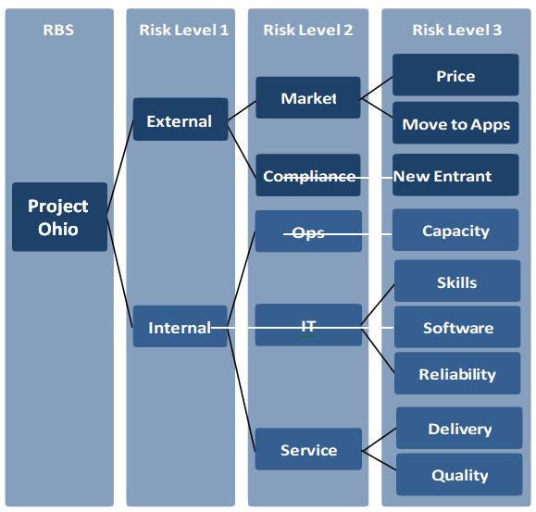
Risk categories
Risk breakdown structure

Slide 97
This provides a structure that ensures a comprehensive process of systematically identifying risks to a consistent level of detail. An organization can use a previously prepared categorization framework, which might take the form of a simple list of categories or might be structured into a Risk Breakdown Structure (RBS) as shown in the diagram above.
This is a hierarchically organized depiction of the identified project risks arranged by risk category and subcategory that identifies the various areas and causes of potential risks.

Slide 98
Definitions of Risk Probability and Impact
This ensures that all stakeholders have a common understanding of these definitions.
For example,
If the probability of a risk can be described as low, medium or high, what do these categories actually mean?
Similarly, what effect would a high impact event have on the project in practical terms? How much would it add to the costs? Could anything be done to mitigate it?
Probability and Impact Matrix
Risks are prioritized according to their potential implications for having an effect on the project’s objectives by using a matrix like structure.

Slide 99
Revised Stakeholder Risk Tolerances
If there is a need to revise stakeholder risk tolerances then these should be documented here.
Reporting Formats
This part of the plan describes how the outcomes of the risk management processes will be documented, analyzed, and communicated. It describes the content and format of the risk register as well as any other risk reports required.
Tracking
This part of the plan describes how risk activities will be recorded for the benefit of the current project, as well as for future needs and lessons learned, as well as whether and how risk management processes will be audited.

Slide 100
Class Exercise
Question 1: Do you agree with the following statement: “With proper planning, it is possible to eliminate most/all risks from a project”? Why or why not?
Question 2: Assessing Risk and Benefits. Suppose you are a member of a project team that is evaluating the bids of potential contractors for developing some subassemblies for your project. Your boss makes it clear that any successful bid must demonstrate a balance between risk and price. Explain how this is so; specifically, why are price and risk seen as equally important but opposite issues in determining the winner of the contract? Is a low-price/high-risk bid acceptable? Is a high-price/low-risk bid acceptable? Why or why not?

Slide 101
Research Paper (Abstract)

Slide 102
Objective:
Demographics:
Problem:
Methodology:
Conclusion:
Validity:

Slide 103
GENERAL PROJECT RISK CHARACTERIZATION
1.Performance, scope, quality, or technological risks.
These include the risks that the project when complete fails to perform as intended or fails to meet the mission or business requirements that generated the justification for the project. Performance risks can also lead to schedule and cost risks if technological problems increase the duration and cost of the project.
2.Environment, safety, and health risks.
These include the risks that the project may have a detrimental effect on the environment or that hidden hazards may be uncovered during project execution. Serious incidents can have a severe impact on schedule and costs.

Slide 104
3.Schedule risk. This is the risk that the project takes longer than scheduled. Schedule risk may also lead to cost risks, as longer projects always cost more, and to performance risk, if the project is completed too late to perform its intended mission fully. Even if cost increases are not severe, delays in project completion reduce the value of the project to the owner.
4.Cost risk. This is the risk that the project costs more than budgeted. Cost risk may lead to performance risk if cost overruns lead to reductions in scope or quality to try to stay within the baseline budget. Cost risk may also lead to schedule risk if the schedule is extended because not enough funds are available to accomplish the project on time.

Slide 105
5.Loss of support. Loss of public or stakeholder support for the project’s goals and objectives may ultimately lead to a reduction of scope and to funding cuts, and thus contribute to poor project performance.
Source: The Owner’s Role in Project Risk Management, “THE NATIONAL ACADEMIES PRESS Washington” , D.C.

Slide 106
GRM Risk Categories
GRM Risk Categories From an extensive review of the literature, including the papers listed in Table 1, nine categories were identified. Respective risks determined for each category. The categories and associated risks are as follows.
(1) Technological and Operational Risk is sub-divided into operational, engineering, and performance risk. Operational risk includes lack of communication and coordination in the project, labor productivity and improper project planning. Engineering risk includes inadequate engineering designs, incomplete project scope, inadequate specifications, and differences between actual values and engineering assumptions. Performance risk includes technology limits and quality.
(2) Financial and Economic Risk is sub-divided into credit default, budget constraint/ scope creep, foreign exchange, inflation and interest rate, insurance, and funding risk. It includes credit fraud, changes in inflation or interest rates, and changes in the price of raw materials. For international projects, changes in exchange rates can cause budget pressures leading to cost overruns and/or decreases in the project performance or scope.

Slide 107
(3) Procurement and Contractual Risk is sub-divided into raw material procurement and subcontractor procurement risk. Raw material procurement risk is the delay due to market competition. Contractual risk involves issues or concerns associated with procurement through contractor.
(4) Political Risk is sub-divided into political instability and customer requirement risk. Political risk can be due to revisions in policies and rules, slow approvals, instable governments, or other bureaucratic hurdles. The political environment can impact projects during the implementation phase. Customer requirement risks can be caused by changes to customer technical or aesthetic requirements, which often lead to scope creep.

Slide 108
(5) Environmental Risk is sub-divided into weather and pollution risk. Risks to the project due to weather conditions such as rain, snow, or reduced sunlight are considered weather risks. Pollution risk is considered when the project affects the environment by generating pollution and vice versa. Generating pollution can result in delays and fines. Working in a polluted environment may affect the project’s performance or cause additional effort to successful complete the project.
(6) Social Risk is sub-divided into cultural relationship and society impact risk. Society impact risk occurs when a project has an effect on society. An example of social risk is the construction of a dam that could disturb the ecological balance of the region. Cultural relationship risk is often associated with global projects. In these situations misunderstanding the needs and sensitivities of the customer can impact the scope and operation of the projects.

Slide 109
(7) Regulatory and Legal Risk is risk sub-divided into litigation and non-compliance with codes and laws. Rules and regulations vary by country and industry sector. Changing regulations can impact a projects’ budget and/or schedule. The risk of litigation is great if rules are not properly followed.
(8) Safety Risk includes security risk. Security risk can be caused by many factors, such as acts of God, fire, theft, terrorism, and war. For example, floods or fire can drastically impact construction projects but they can influence any type of project if deliveries are impacted.
(9) Delay Risk is sub-divided into project delay and third party delay risk. Project delay risk can be caused by plan approval delays or other constraints. Third party delay risk is caused by delays by sub-contractors, suppliers, or vendors.
Reference: Murray, S. L., Grantham, K., & Damle, S. B. (2011). Development of a generic risk matrix to manage project risks. Journal of Industrial and Systems Engineering, 5(1), 35-51.

Slide 110
Framework to Identify Sources of Overall Project Risks
• PESTLE (political, economic, social, technological, legal, environment)
• TECOP (technical, environmental, commercial, operational, political)
• VUCA (volatility, uncertainty, complexity, ambiguity)

Slide 111
The End.

